Slide 1
Key Management and Distribution
topics of cryptographic key management / key distribution are complex
  cryptographic, protocol, & management issues
symmetric schemes require both parties to share a common secret key
public key schemes require parties to acquire valid public keys
have concerns with doing both
Notes:
The topics of cryptographic key management and cryptographic key distribution are complex, involving cryptographic, protocol, and management considerations. The purpose of this presentation is to give the reader a feel for the issues involved and a broad survey of the various aspects of key management and distribution.

Slide 2
Key Distribution
symmetric schemes require both parties to share a common secret key
issue is how to securely distribute this key
whilst protecting it from others
frequent key changes can be desirable
often secure system failure due to a break in the key distribution scheme
Notes:
For symmetric encryption to work, the two parties to an exchange must share the same key, and that key must be protected from access by others. Furthermore, frequent key changes are usually desirable to limit the amount of data compromised if an attacker learns the key. This is one of the most critical areas in security systems - on many occasions systems have been broken, not because of a poor encryption algorithm, but because of poor key selection or management. It is absolutely critical to get this right!

Slide 3
Symmetric
Key Distribution
given parties A and B have various key distribution alternatives:
  A can select key and physically deliver to B
  third party can deliver key to A & B
  if A & B have communicated previously can use previous key to encrypt a new key
Notes:
The strength of any cryptographic system thus depends on the key distribution technique. For two parties A and B, key distribution can be achieved in a number of ways:
Physical delivery (1 & 2) is simplest - but only applicable when there is personal contact between recipient and key issuer. This is fine for link encryption where devices & keys occur in pairs, but does not scale as number of parties who wish to communicate grows (see next slide). 3 is mostly based on 1 or 2 occurring first, and also suffers that if an attacker ever succeeds in gaining access to one key, then all subsequent keys will be revealed.
A third party, whom all parties trust, can be used as a trusted intermediary to mediate the establishment of secure communications between them (4). Must trust intermediary not to abuse the knowledge of all session keys. As number of parties grow, some variant of 4 is only practical solution to the huge growth in number of keys potentially needed.

Slide 4
Public Key Deception
Impostor
“I am the True Person.”
“Here is TP’s public key.”
(Sends Impostor’s public key)
“Here is authentication
based on TP’s private key.”
(Really Impostor’s private key)
Decryption of message from Verifier
encrypted with Imposter’s public key,
so Impostor can decrypt it
Verifier
Must authenticate True Person.
Believes now has
TP’s public key
Believes True Person
is authenticated
based on Impostor’s public key
“True Person,
here is a message encrypted
with your public key.”
Critical
Deception

Slide 5
Public Key
Distribution
parties A and B have various key distribution alternatives:
  A can publish PK on a web site + MD, DS
  A can upload PK to a key server(s) MD
  if A & B have secure communications with a third party C, C can relay key between A & B (digital certificate-DC)
Notes:
The strength of any cryptographic system thus depends on the key distribution technique. For two parties A and B, key distribution can be achieved in a number of ways:
Physical delivery (1 & 2) is simplest - but only applicable when there is personal contact between recipient and key issuer. This is fine for link encryption where devices & keys occur in pairs, but does not scale as number of parties who wish to communicate grows (see next slide). 3 is mostly based on 1 or 2 occurring first, and also suffers that if an attacker ever succeeds in gaining access to one key, then all subsequent keys will be revealed.
A third party, whom all parties trust, can be used as a trusted intermediary to mediate the establishment of secure communications between them (4). Must trust intermediary not to abuse the knowledge of all session keys. As number of parties grow, some variant of 4 is only practical solution to the huge growth in number of keys potentially needed.

Slide 6
X.509 Certificates
issued by a Certification Authority (CA), containing:
  version V (1, 2, or 3)
  serial number SN (unique within CA) identifying certificate
  signature algorithm identifier AI
  issuer X.500 name CA)
  period of validity TA (from - to dates)
  subject X.500 name A (name of owner)
  subject public-key info Ap (algorithm, parameters, key)
  issuer unique identifier (v2+)
  subject unique identifier (v2+)
  extension fields (v3)
  signature (of hash of all fields in certificate)
notation CA<<A>> denotes certificate for A signed by CA
Notes:
The heart of the X.509 scheme is the public-key certificate associated with each user. There are 3 versions, with successively more info in the certificate - must be v2 if either unique identifier field exists, must be v3 if any extensions are used. These user certificates are assumed to be created by some trusted certification authority (CA) and placed in the directory by the CA or by the user. The directory server itself is not responsible for the creation of public keys or for the certification function; it merely provides an easily accessible location for users to obtain certificates. The certificate includes the elements shown, see text for further details.
The standard uses the notation for a certificate of: CA<<A>> where the CA signs the certificate for user A with its private key. In more detail CA<<A>> = CA {V, SN, AI, CA, UCA, A, UA, Ap, TA}. If the corresponding public key is known to a user, then that user can verify that a certificate signed by the CA is valid.

Slide 7
Obtaining a Certificate
any user with access to CA can get any certificate from it
only the CA can modify a certificate
because cannot be forged, certificates can be placed in a public directory
Notes:
User certificates generated by a CA have the characteristics that any user with access to the public key of the CA can verify the user public key that was certified, and no party other than the certification authority can modify the certificate without this being detected. Because certificates are unforgeable, they can be placed in a directory without the need for the directory to make special efforts to protect them.

Slide 8
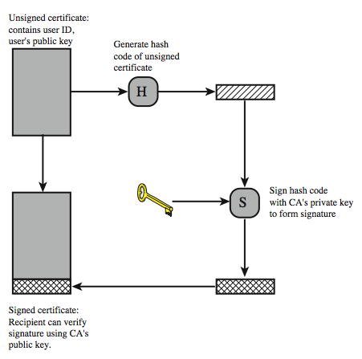
X.509 Certificate Use
Notes:
X.509 is based on the use of public-key cryptography and digital signatures. The standard does not dictate the use of a specific algorithm but recommends RSA. The digital signature scheme is assumed to require the use of a hash function. Again, the standard does not dictate a specific hash algorithm. The 1988 recommendation included the description of a recommended hash algorithm; this algorithm has since been shown to be insecure and was dropped from the 1993 recommendation.

Slide 9
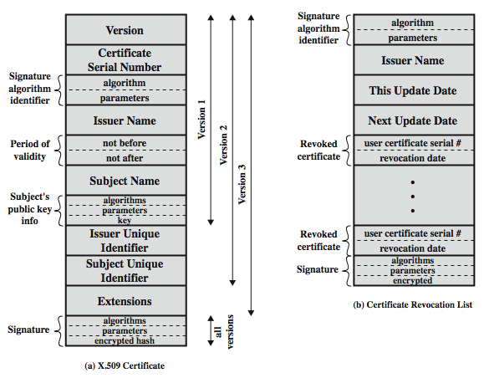
X.509 Certificates

Slide 10
CA Hierarchy
if both users share a common CA then they are assumed to know its public key
otherwise CA's must form a hierarchy
use certificates linking members of hierarchy to validate other CA's
  each CA has certificates for clients (forward) and parent (backward)
each client trusts parents certificates
enable verification of any certificate from one CA by users of all other CAs in hierarchy
Notes:
If both parties use the same CA, they know its public key and can verify others certificates. If there is a large community of users, it may not be practical for all users to subscribe to the same CA. With many users, it may be more practical for there to be a number of CAs, each of which securely provides its public key to some fraction of the users. Hence there has to be some means to form a chain of certifications between the CA's used by the two parties, by the use of client and parent certificates. All these certificates of CAs by CAs need to appear in the directory, and the user needs to know how they are linked to follow a path to another user's public-key certificate. X.509 suggests that CAs be arranged in a hierarchy so that navigation is straightforward. It is assumed that each client trusts its parents certificates.

Slide 11
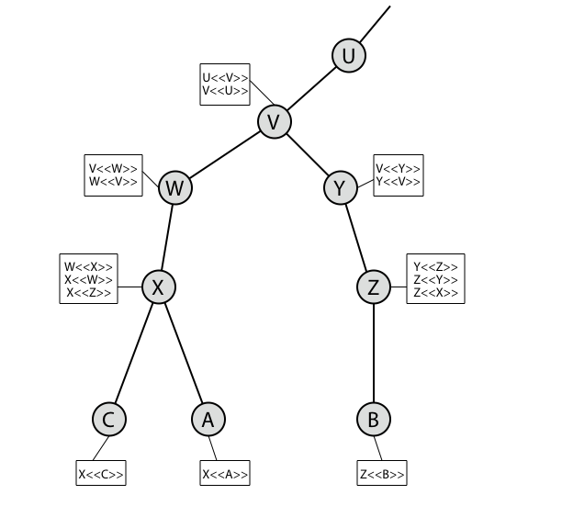
CA Hierarchy Use
Notes:
Figure illustrates the use of an X.509 hierarchy to mutually verify clients certificates. The connected circles indicate the hierarchical relationship among the CAs; the associated boxes indicate certificates maintained in the directory for each CA entry. The directory entry for each CA includes two types of certificates: Forward certificates: Certificates of X generated by other CAs, and Reverse certificates: Certificates generated by X that are the certificates of other CAs.
In this example, we can track chains of certificates as follows:
A acquires B certificate using chain: X<<W>>W<<V>>V<<Y>>Y<<Z>>Z<<B>>
B acquires A certificate using chain: Z<<Y>>Y<<V>>V<<W>>W<<X>>X<<A>>

Slide 12
Certificate Revocation
certificates have a period of validity
may need to revoke before expiry, eg:
  user's private key is compromised
  user is no longer certified by this CA
  CA's certificate is compromised
CA’s maintain list of revoked certificates
  the Certificate Revocation List (CRL)
users should check certificates with CA’s CRL
Notes:
A certificate includes a period of validity. Typically a new certificate is issued just before the expiration of the old one.
In addition, it may be desirable on occasion to revoke a certificate before it expires, for one of a range of reasons, such as those shown above.
To support this, each CA must maintain a list consisting of all revoked but not expired certificates issued by that CA, known as the certificate revocation list (CRL). Each certificate revocation list (CRL) posted to the directory is signed by the issuer and includes the issuer's name, the date the list was created, the date the next CRL is scheduled to be issued, and an entry for each revoked certificate. Each entry consists of the serial number of a certificate and revocation date for that certificate. Because serial numbers are unique within a CA, the serial number is sufficient to identify the certificate.
When a user receives a certificate in a message, the user must determine whether the certificate has been revoked, by checking the directory CRL each time a certificate is received, this often does not happen in practice.

Slide 13
X.509 Version 3
has been recognised that additional information is needed in a certificate
  email/URL, policy details, usage constraints
rather than explicitly naming new fields defined a general extension method
extensions consist of:
  extension identifier
  criticality indicator
  extension value
Notes:
The X.509 version 2 format does not convey all of the information that recent design and implementation experience has shown to be needed. Rather than continue to add fields to a fixed format, standards developers felt that a more flexible approach was needed. X.509 version 3 includes a number of optional extensions that may be added to the version 2 format. Each extension consists of an extension identifier, a criticality indicator, and an extension value. The criticality indicator indicates whether an extension can be safely ignored or not (in which case if unknown the certificate is invalid).

Slide 14
Certificate Extensions
key and policy information
  convey info about subject & issuer keys, plus indicators of certificate policy
certificate subject and issuer attributes
  support alternative names, in alternative formats for certificate subject and/or issuer
certificate path constraints
  allow constraints on use of certificates by other CA’s
Notes:
The certificate extensions fall into three main categories:
key and policy information - convey additional information about the subject and issuer keys, plus indicators of certificate policy. A certificate policy is a named set of rules that indicates the applicability of a certificate to a particular community and/or class of application with common security requirements.
subject and issuer attributes - support alternative names, in alternative formats, for a certificate subject or certificate issuer and can convey additional information about the certificate subject; eg. postal address, email address, or picture image
certification path constraints - allow constraint specifications to be included in certificates issued for CA’s by other CA’s that may restrict the types of certificates that can be issued by the subject CA or that may occur subsequently in a certification chain.

Slide 15
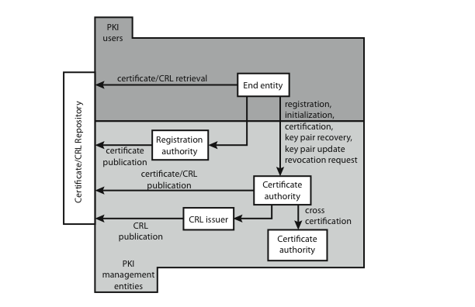
Public Key Infrastructure
Notes:
RFC 2822 (Internet Security Glossary) defines public-key infrastructure (PKI) as the set of hardware, software, people, policies, and procedures needed to create, manage, store, distribute, and revoke digital certificates based on asymmetric cryptography. Its principal is to enable secure, convenient, and efficient acquisition of public keys. The IETF Public Key Infrastructure X.509 (PKIX) working group has setup a formal (and generic) model based on X.509 that is suitable for deploying a certificate-based architecture on the Internet.
Figure above shows interrelationships among some key elements:
• End entity: A generic term used to denote end users, devices (e.g., servers, routers), or any other entity that can be identified in the subject field of a public key certificate. End entities canconsume and/or support PKI-related services.
• Certification authority (CA): The issuer of certificates and (usually) certificate revocation lists (CRLs). It may also support a variety of administrative functions, although these are often delegated to Registration Authorities.
• Registration authority (RA): An optional component that can assume a number of administrative functions from the CA. The RA is often associated with the End Entity registration process, but can assist in a number of other areas as well.
• CRL issuer: An optional component that a CA can delegate to publish CRLs.
• Repository: A generic term used to denote any method for storing certificates and CRLs so that they can be retrieved by End Entities.

